Slide 1

The Zero Lower Bound, ECB Interest Rate Policy and the Financial Crisis
Stefan Gerlach, IMFS, and John Lewis, DNB

Slide 2
Introduction
CBs across the world responded to the financial crisis by cutting interest rates rapidly.
Two factors may have played a role:
  Sharp deterioration of macro economic conditions.
  Non-zero probability that the Zero Lower Bound (ZLB) would become a constraint.
Did the ZLB influence ECB’s interest rate setting?
  Difficult know & competing explanations possible.
  We argue that it probably did.

Slide 3
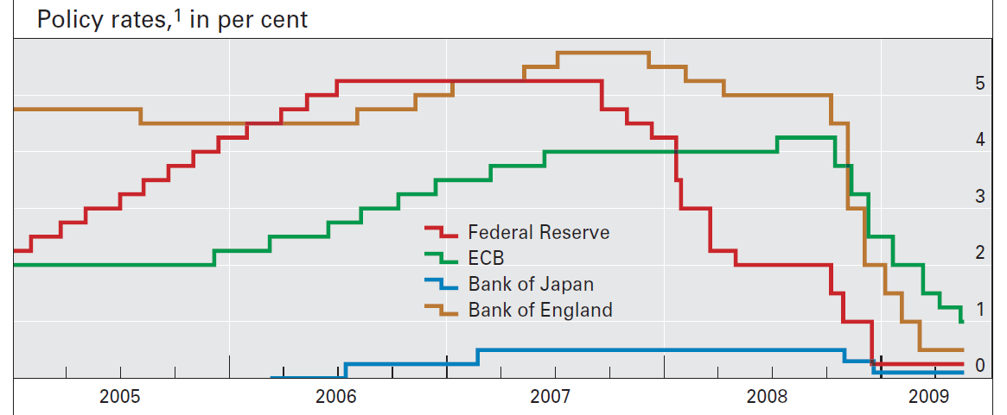

Slide 4
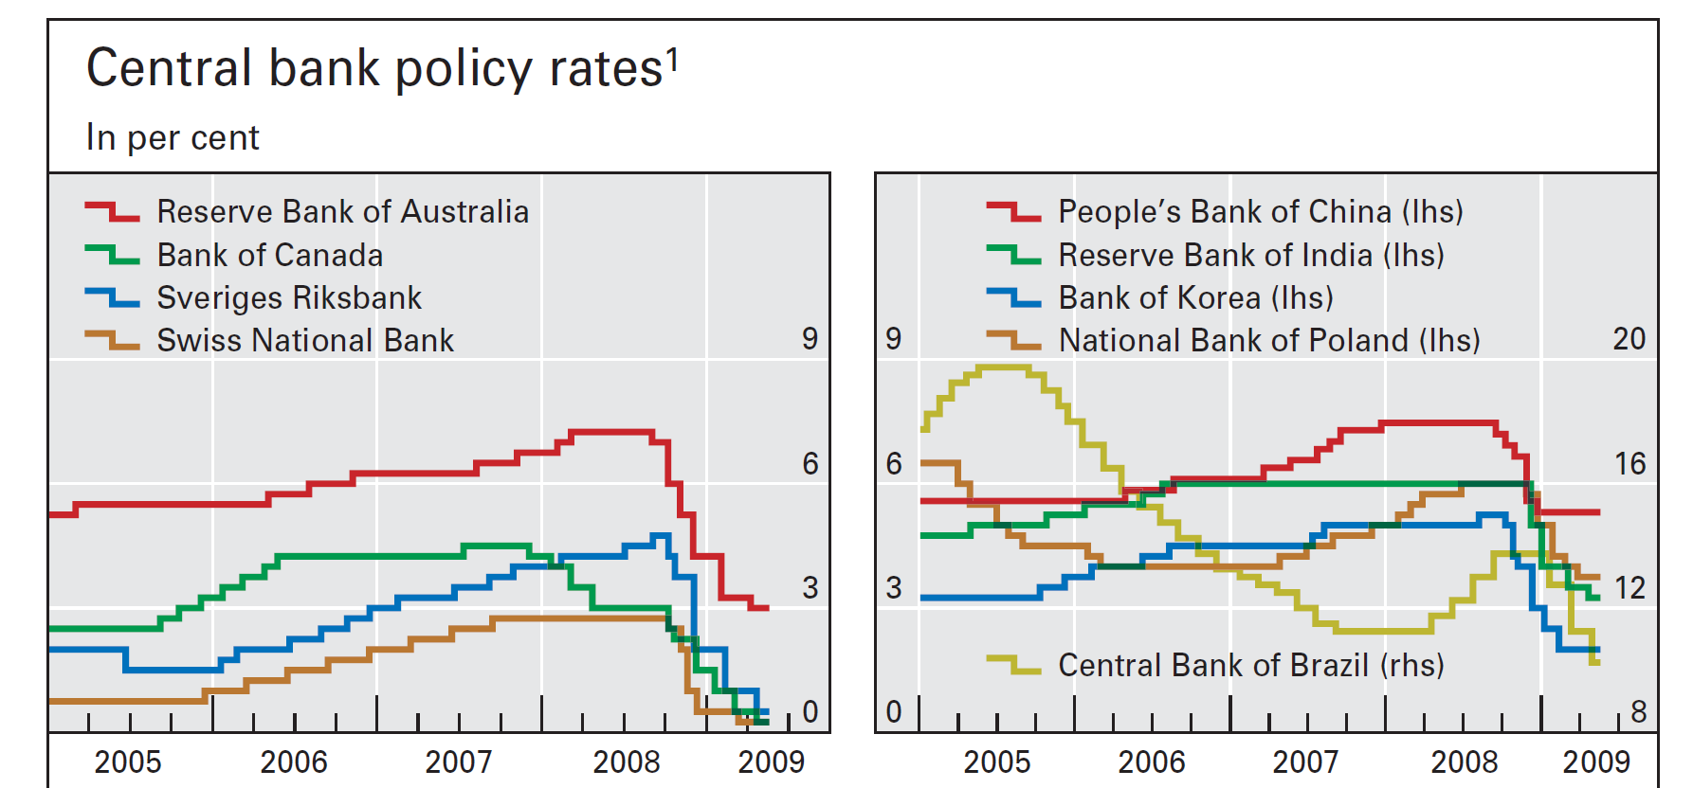

Slide 5
ZLB and Monetary Policy
ZLB rediscovered by Summers (1991) but seen as a curiosity of little practical relevance to MP.
The global decline in inflation in the late 1990s triggered much research on the ZLB.
  Experiences of Japan.

Slide 6
One can imagine three approaches to monetary policy in the vicinity of the ZLB.
  Let i*= f(π, y, …) denote the “optimal” interest rate in the absence of the ZLB.
  Normally, when i* >> 0, the CB’s policy problem is to determine i* and then sets i = i*.
  When i* < 0, the ZLB binds.
  Question is how does the CB set i as i* approaches 0?
First approach:
  Set i = i* until the ZLB is reached and then set i = 0.

Slide 7
Second approach:
  Cut interest rates aggressively if the economy deteriorates and maintain them at this level longer (“extended period of time”) than implied by i*.
    i < i* as the economy weakens.
  Reifschneider and Williams (JMCB, 2000):
    AD determined by long interest rates, which depend on the expected future path of short rates, i.
    By setting i < i* before and after the ZLB binds, CB might compensate for the fact i > i* when the ZLB binds.
    May be possible to achieve a long interest rate similar to that would have been observed if the ZLB had been irrelevant.

Slide 8
Third approach:
  Keep the gun power dry.
    Set i > i* so as to have more room to cut if needed.
  No formal model.
  Bini-Smaghi (2008):
    Could worsen market sentiment.
    If rates are cut early, little room to cut rates if economy weakens further.
    Seems to disregard the fact that on “early” cut in i makes it less likely that i* turns negative.

Slide 9
Interest rates
i
i
Time
i*

Slide 10
Our empirical approach
Unfortunately, i* is not observed.
  Estimate reaction function (RF) that may shift during sample.
    Use pre-crisis function to predict i during crisis and think of this as an estimate of i*.
    Involves predicting i in conditions very different from those in sample period.
    Gives us a sense of when, how rapidly and why the shift occurred.
  Compare actual i with predicted i*.
    Did ECB cut rates faster than implied by pre-crisis RF?

Slide 11
1. Switching as a function of time
Many ways to model the shift:
  Piece-wise linear.
    Assumes break instantaneous.
  Markow switching.
    Assenmacher-Wesche (EER 2006).
  Smooth transition.
    Mankiw, Miron and Weil (AER 1987).

Slide 12
Target level of interest rate:
Gradual adjustment:
Reaction function:

Slide 13
Data choice:
  Overnight rate rather than repo rate!
    ON rates fell much below repo rate.
    Reflects a policy choice, not an accident.
  PMI rather than GAP.
    Available with minimal lag.
    Strongly correlated with y/y growth rate of real GDP.
  HICP inflation.
  M3.
  Nominal effective exchange rate.

Slide 16
Equations for each regime:
Composite equation:
Variance of errors:
Logistic transition:
Notes:
Note that the errors heteroscedastic so equation can’t be estimated by OLS.
Estimate parameters in Θ1 and Θ2, κ and λ.
Note that when τ = λ, ω = ½ -- this is the “switching point”

Slide 18
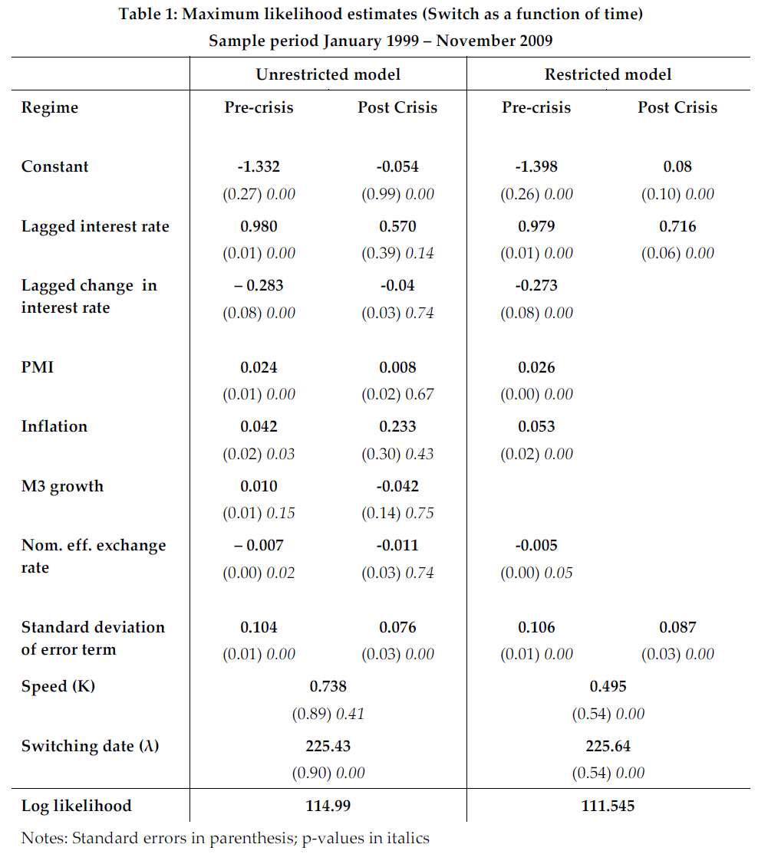

Slide 19
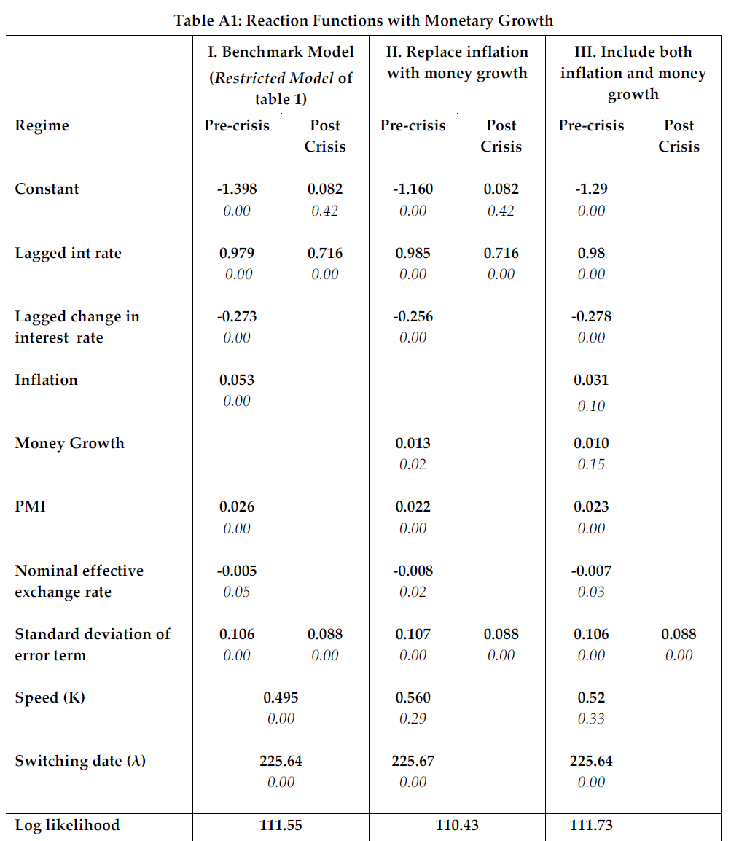

Slide 20
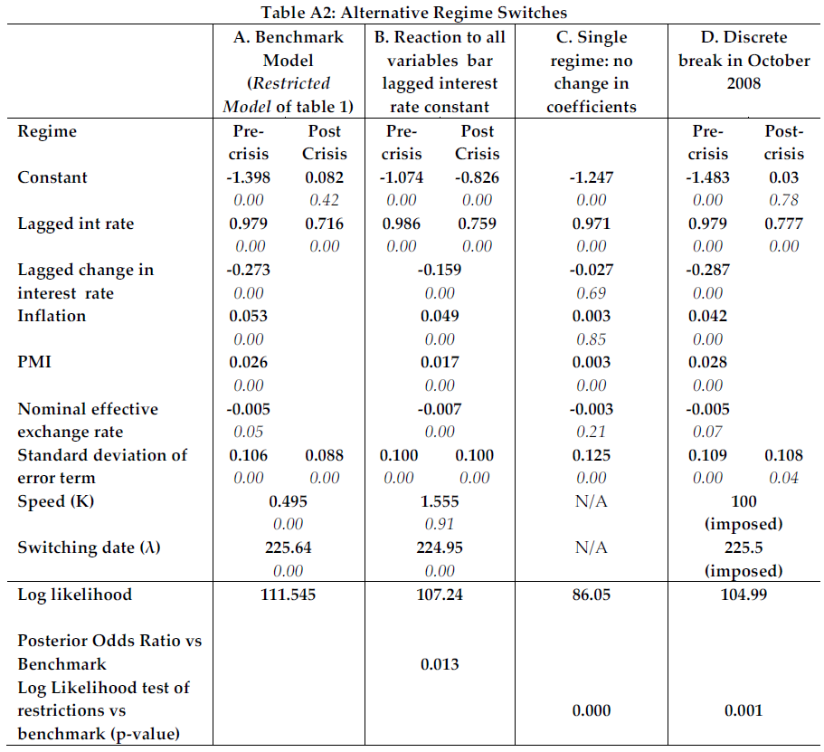

Slide 22
One-step-ahead (static) forecasts, conditional on estimated switch.
Notes:
Rates low just after crisis – reflects the effects on on rates of the liqudity operations of the ECB.
Rates shot up after Lehman collapsed on Sept. 15.
Amazingly good forecasts thereafter.

Slide 23
Dynamic forecasts, conditional on realised values of regressors and assuming no switch.
Notes:
Predicted rate falls sharply, reflecting macroeconomic weakness.
Rates were cut much faster than predicted, so the reaction function changed.
Part of the 95% confidence bound reaches zero, so concerns about ZLB were warranted.

Slide 24
Summary of 1st set of results
Evidence that the reaction function shifted.
Interest rates were much below those predicted by the pre-crisis reaction function.
Compatible with the idea that ECB worried about ZLB.
Problems:
  No explanation for shift; only estimates of when it and how fast it occurred.
  Return to pre-crisis reaction function not possible.

Slide 25
2. Switching and economic conditions
Allow for switch as a function of state of the economy.
  Real GDP growth over 12 months, g.
  Interpolated.

Slide 26
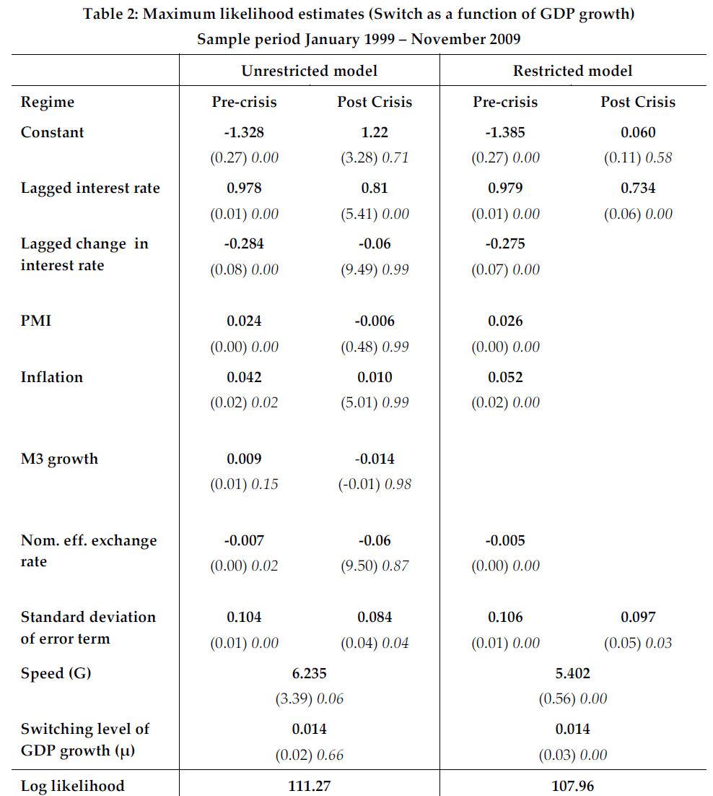

Slide 30
Conclusions
The ECB’s RF shifted during the financial crisis at around the time of the collapse of Lehmann.
  Real economic activity drove change.
Out finding are compatible with ZLB literature.
  Dynamic forecasts point small probability of i* < 0.
Competing explanations possible:
  Orphanides (2010) suggests that a RF for the ECB that uses forecasts as RHS is stable and predicts interest rate setting also during the crisis.

