Slide 1
What’s the story: A new perspective on value of economic forecasts
Presented by
Nitish Ranjan Sinha
Board of Governors of the Federal Reserve System
2nd October 2017
Sharpe, Sinha, Hollrah
What’s the story
10/02/2017

Slide 2
The analysis and conclusions set forth are those of the authors and do not indicate concurrence by other members of the research staff or the Board of Governors.

Slide 3
A new perspective on the value of economic forecasts
Economic forecasts have a dismal track record and are widely disparaged.
But substantial resources continue to be devoted to producing detailed economic forecasts.
Provide a new perspective on why consumers of economic forecasts – financial market participants and policy makers – continue to pay for them.
Sharpe, Sinha, Hollrah
What’s the story
10/02/2017
3
Notes:
3

Slide 4
Studies focus on the track record of point estimates
But plausible that policymakers and investors who pay for these forecasts draw substantial value from narratives that accompany individual forecasts.
Attempt to quantify those narratives by constructing a summary measure of the sentiment embedded in the Greenbook text.
Find this measure -- “Tonality” – helps predict key metrics of economy: Inflation, Unemployment, GDP Growth, and the Federal Funds rate.
Tonality also predicts 3-month and 6-month stock returns.
Sharpe, Sinha, Hollrah
What’s the story
10/02/2017
4
Notes:
4

Slide 5
Focus here on information contained in Greenbook text
Federal Reserve Board’s staff produces a forecast prior to each meeting.
Fed’s forecast has been widely analyzed, found to be superior to private forecasts, though less so in recent decades.
Text describes the forecast in great detail in Greenbook Part 1.
Use Greenbooks from 1973 - 2009.
Sharpe, Sinha, Hollrah
What’s the story
10/02/2017
5
Notes:
5

Slide 6
Related Literature
Large literature on forecast efficiency.
Extracting sentiment from news/10 Ks in finance and accounting
  Tetlock (2007), Laughran and McDonald (2010) and …..
Relatively new literature on text as economic data
  Media bias: Groseclose and Milyo (2005), Gentzkow and Shapiro (2010)
  Policy Uncertainty: Baker et. al. (2016), Husted, Rogers and Sun (2017)
  Information in news: Tetlock (2007), Shapiro, Sudhof and Wilson (2017)
  Quantify FOMC communication: Carvalho, Hsu and Nechio (2016)
Sharpe, Sinha, Hollrah
What’s the story
10/02/2017
6
Notes:
6

Slide 7
Roadmap
What is Tonality?
Tonality as an Economic Indicator
  Tonality and Blue Chip Forecasts
Tonality and Monetary Policy
Tonality and Asset Prices
Extensions
Sharpe, Sinha, Hollrah
What’s the story
10/02/2017
7
Notes:
7

Slide 8
We construct summary measure of the sentiment or tone of Greenbook, called Tonality
Based on counts of words classified as either positive or negative.
Starting point: Harvard Psycho-social dictionary, fine-tuned by excluding words such as “demean.”
  231 Positive words, 102 negative words
Compare the number of positive and negative words in text, each word inversely weighted by frequency it appears over the previous five years and by the frequency it appears in the current document (tf-idf weight).
  words that tend to be infrequently used presumed to be especially informative.
Sharpe, Sinha, Hollrah
What’s the story
10/02/2017
8
Notes:
8

Slide 9
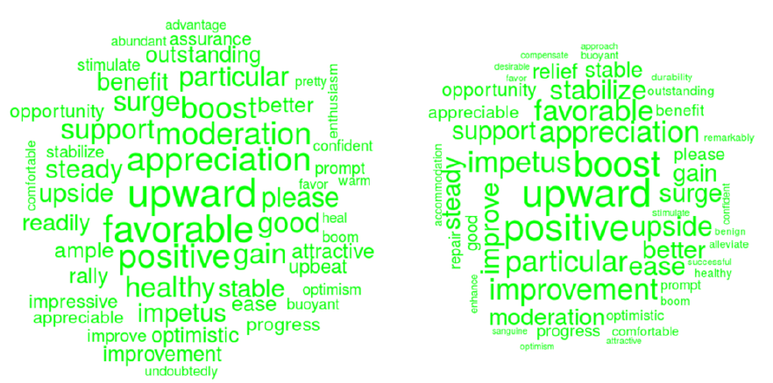
Positive words in the Greenbook
50 most positive words Jan 1994 - Dec 1998, and Jan 2005 - Dec 2009, word size proportional to its contribution to Tonality. Slightly bigger word cloud in 1994-1998. “Favorable” and “Moderation” more prominent in 1994-1998.
Sharpe, Sinha, Hollrah
What’s the story
10/02/2017
9
Notes:
9

Slide 10
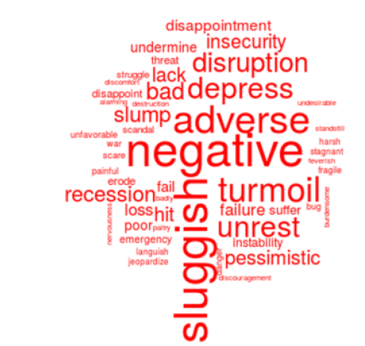
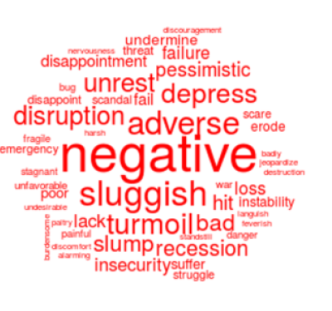
Negative words in the Greenbook
50 most negative words Jan 1994 - Dec 1998, and Jan 2005 - Dec 2009, word size proportional to its contribution to Tonality. Bigger word cloud in 2005-2009. “Adverse”, “Recession” and “Turmoil” more prominent in 2005-2009.
Sharpe, Sinha, Hollrah
What’s the story
10/02/2017
10
Notes:
10

Slide 11
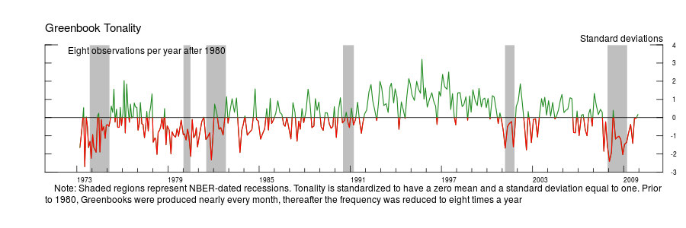
Tonality over time
Tonality is normalized to have zero mean and unit standard deviation.
Tonality tends to be mostly negative during recessions, positive when the economy enters an expansionary period.
Sharpe, Sinha, Hollrah
What’s the story
10/02/2017
11
Notes:
11

Slide 12
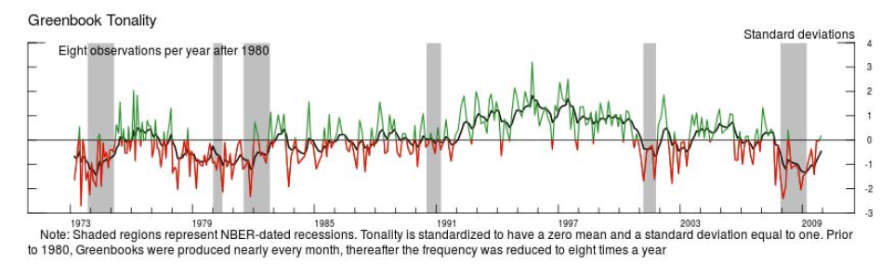
Estimate “Trend Tonality” by smoothing Tonality
Obtain Trend Tonality from an exponentially weighted moving average. Similar to a Kalman filter under the assumption that Trend Tonality followed a random walk.
Tonality = Trend Tonality + Tonality Shock
Sharpe, Sinha, Hollrah
What’s the story
10/02/2017
12
Notes:
12

Slide 13
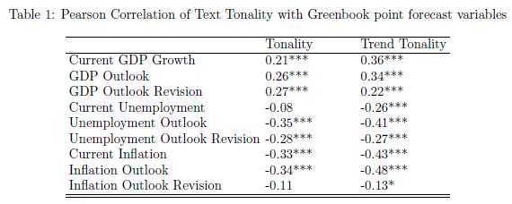
Tonality and Fed’s Forecast
Tonality of the narrative appears to be correlated with all 3 key measures of modal forecast, with intuitive sign.
Table 1: Tonality and Trend Tonality mostly correlate more with Inflation & GDP outlook than with revisions to outlook; for unemployment, also revisions
To examine marginal importance of factors in multivariate context, we exclude a couple “redundant” factors
Sharpe, Sinha, Hollrah
What’s the story
10/02/2017
13
Notes:
13

Slide 14
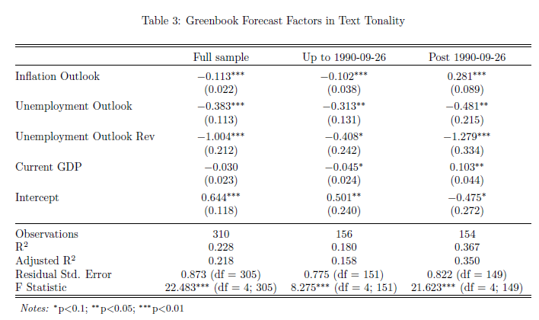
Which factors are more important for Tonality
Over full sample, Inflation and unemployment outlooks, and revision to unemployment outlook account for 22% of variation in Tonality.
Similar results for Trend Tonality, but higher R-squared.
Sharpe, Sinha, Hollrah
What’s the story
10/02/2017
14
Notes:
14

Slide 15
Consider breaks in Tonality determinants
Dominant break 1990: Tonality more strongly connected to factors post-90.
Inflation outlook goes from neg to pos factor; Unemp outlook rev. becomes stronger; current GDP growth goes from marginal neg. to pos.
Sharpe, Sinha, Hollrah
What’s the story
10/02/2017
15
Notes:
15

Slide 16
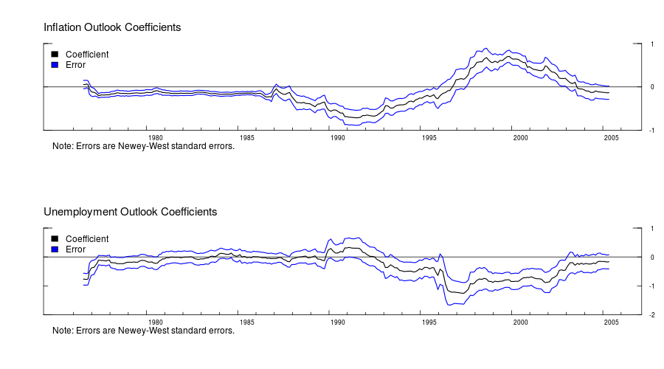
Drivers of Tonality over 10-year rolling window
Sharpe, Sinha, Hollrah
What’s the story
10/02/2017
16
Notes:
16

Slide 17
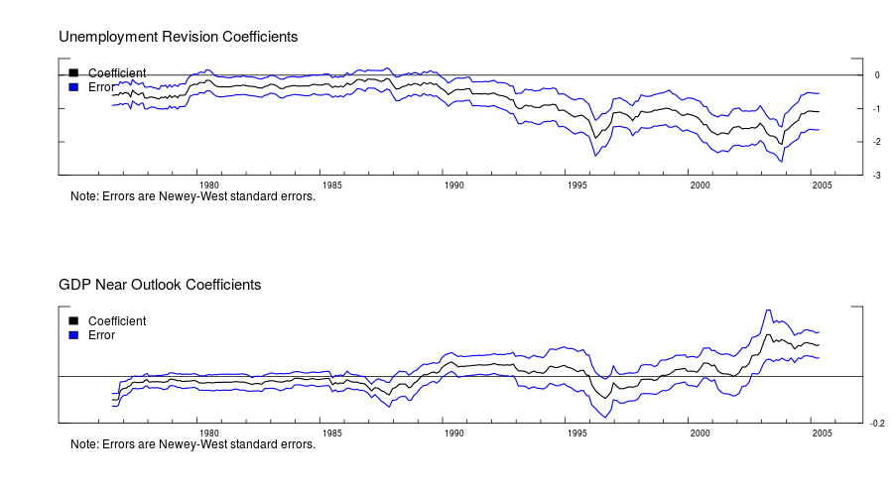
Drivers of Tonality over 10-year rolling window
Sharpe, Sinha, Hollrah
What’s the story
10/02/2017
17
Notes:
17

Slide 18
Outline
What is Tonality?
Tonality as an Economic Indicator
  Tonality and Blue Chip Forecasts
Tonality and Monetary Policy
Tonality and Asset Prices
Extensions
Sharpe, Sinha, Hollrah
What’s the story
10/02/2017
18
Notes:
18

Slide 19
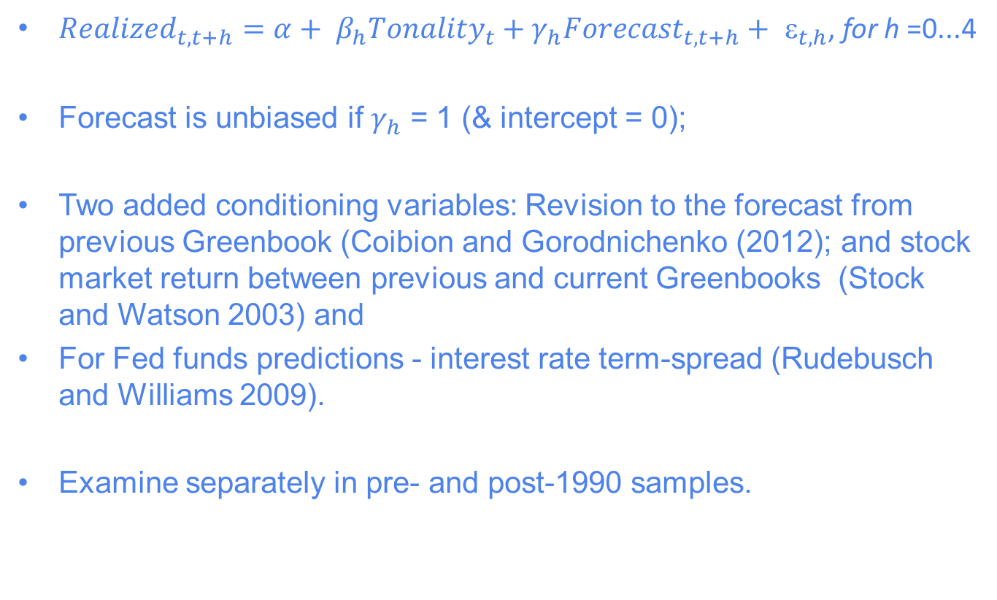
Tonality as an Economic Indicator
${Realized}_{t,t+h}=α+ β_{h}{Tonality}_{t}+γ_{h}{Forecast}_{t,t+h}+{ }_{t,h}$, for h =0...4
Forecast is unbiased if $γ_{h}$ = 1 (& intercept = 0);
Two added conditioning variables: Revision to the forecast from previous Greenbook (Coibion and Gorodnichenko (2012); and stock market return between previous and current Greenbooks (Stock and Watson 2003) and
For Fed funds predictions - interest rate term-spread (Rudebusch and Williams 2009).
Examine separately in pre- and post-1990 samples.
Sharpe, Sinha, Hollrah
What’s the story
10/02/2017
19
Notes:
19

Slide 20
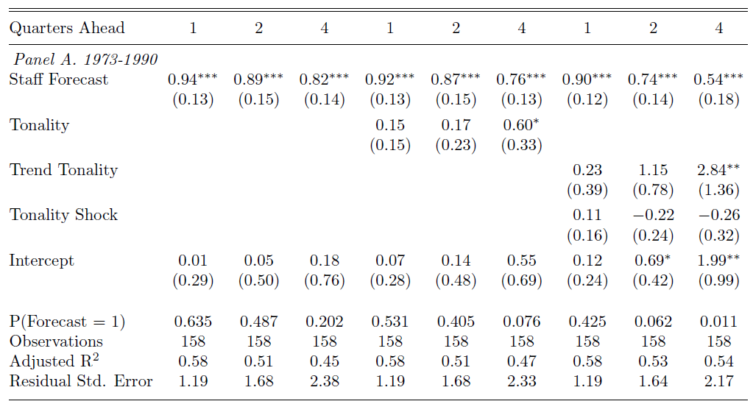
Predicting GDP growth with Tonality
More optimism in text conveys positive incremental information for GDP, especially at longer horizons (and in later sample)
Fade staff forecast somewhat (relative to mean)
Interpretation: put some weight on modal forecast, some on tonality
Trend Tonality is a better predictor than Tonality
Sharpe, Sinha, Hollrah
What’s the story
10/02/2017
20
Notes:
20

Slide 21
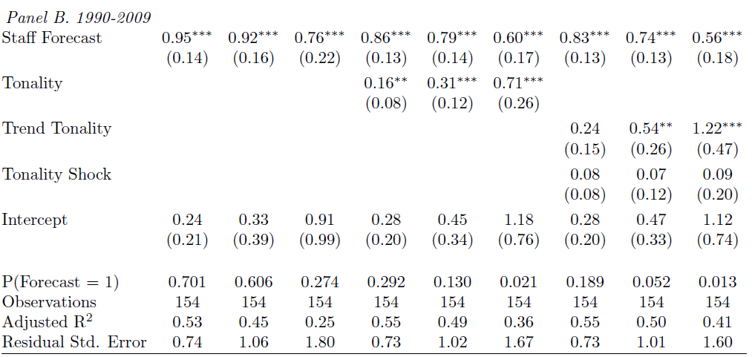
Predicting GDP growth with Tonality
More optimism in text conveys positive incremental information for GDP, especially at longer horizons (and in later sample)
Fade staff forecast somewhat (relative to mean)
Interpretation: put some weight on modal forecast, some on tonality
Trend Tonality is a better predictor than Tonality
Sharpe, Sinha, Hollrah
What’s the story
10/02/2017
21
Notes:
21

Slide 22
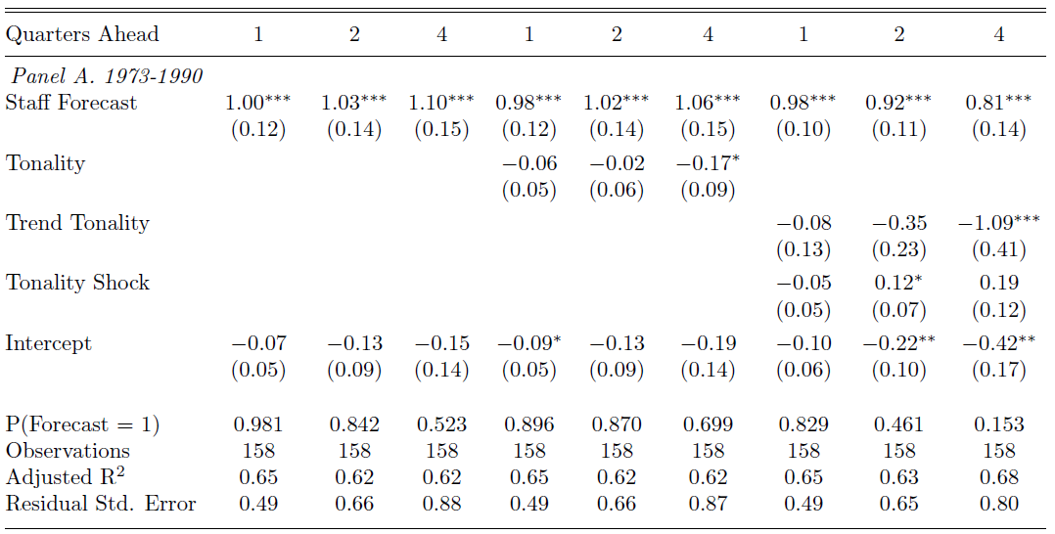
Predicting Unemployment with Tonality
Tonality has even stronger benefit for predicting unemployment, again in later period.
Again, Trend Tonality stronger than just Tonality. Higher R-squared.
Sharpe, Sinha, Hollrah
What’s the story
10/02/2017
22
Notes:
22

Slide 23
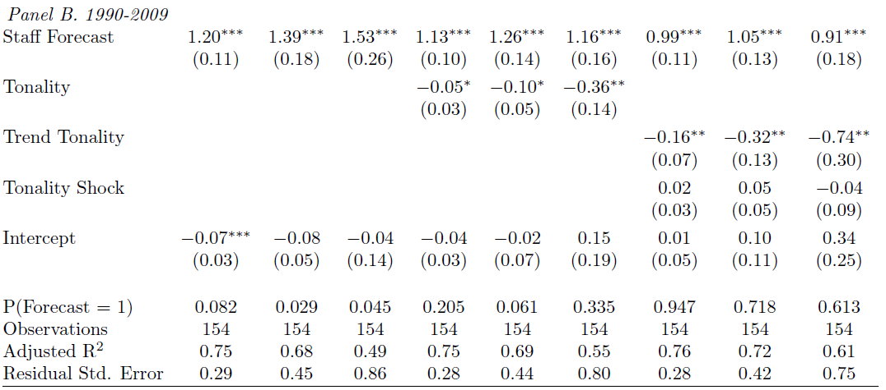
Predicting Unemployment with Tonality
Tonality has even stronger benefit for predicting unemployment, again in later period.
Again, Trend Tonality stronger than just Tonality. Higher R-squared.
Sharpe, Sinha, Hollrah
What’s the story
10/02/2017
23
Notes:
23

Slide 24
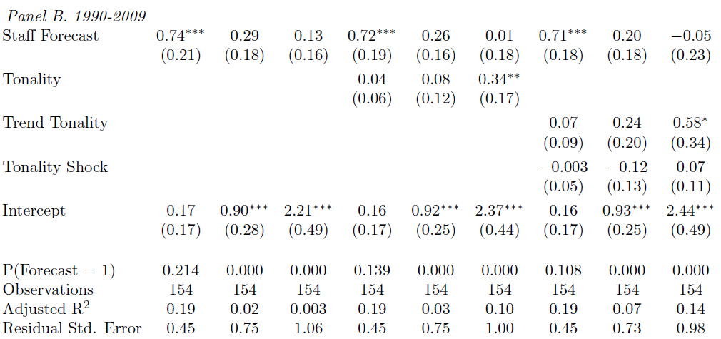
Predicting Inflation with Tonality
Not much help for predicting inflation, even with Trend Tonality.
Optimal to fade staff forecast entirely in late period
  Echo previous findings that inflation less predictable post-moderation
Sharpe, Sinha, Hollrah
What’s the story
10/02/2017
24
Notes:
24

Slide 25
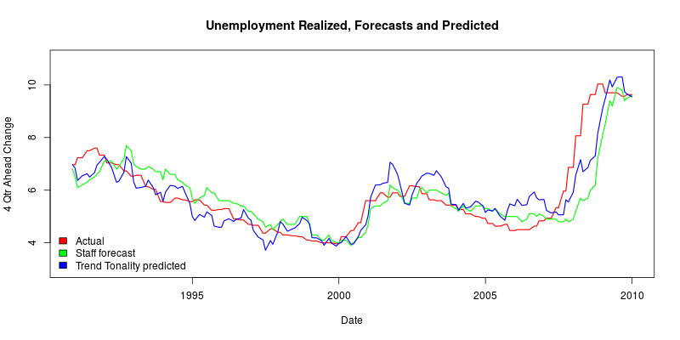
Trend Tonality as a predictor of Unemployment
Sharpe, Sinha, Hollrah
What’s the story
10/02/2017
25
Notes:
25

Slide 26
Outline
What is Tonality?
Tonality as an Economic Indicator
  Tonality and Blue Chip Forecasts
Tonality and Monetary Policy
Tonality and Asset Prices
Extensions
Sharpe, Sinha, Hollrah
What’s the story
10/02/2017
26
Notes:
26

Slide 27
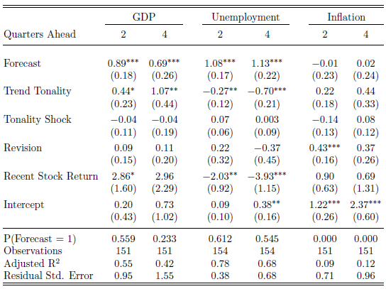
Greenbook Tonality and Blue Chip forecasts
Results are similar to those for Greenbook forecasts: suggesting predictive content of Tonality is unrelated to complementarity between Fed staff’s numerical forecast and Tonality
Sharpe, Sinha, Hollrah
What’s the story
10/02/2017
27
Notes:
27

Slide 28
Outline
What is Tonality?
Tonality as an Economic Indicator
  Tonality and Blue Chip Forecasts
Tonality and Monetary Policy
Tonality and Asset Prices
Extensions
Sharpe, Sinha, Hollrah
What’s the story
10/02/2017
28
Notes:
28

Slide 29
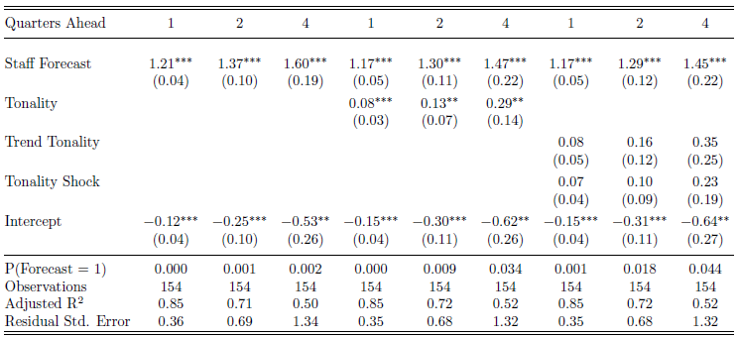
Tonality as a Predictor of Monetary Policy
Tonality predicts changes to the Fed Funds Rate, no gain from Trend vs Tonality shock.
Also optimal to consider FF forecast as a signal – Reifschneider and Tulip (2017), instead of a true forecast.
Sharpe, Sinha, Hollrah
What’s the story
10/02/2017
29
Notes:
29

Slide 30
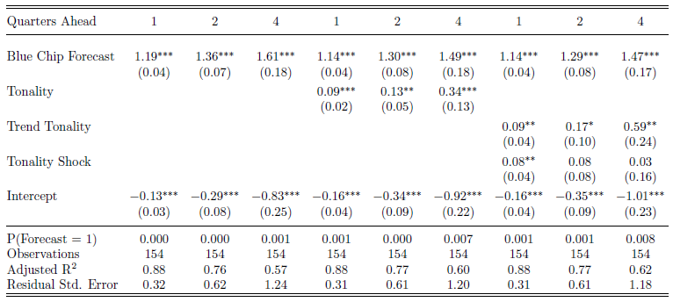
Tonality as a Predictor of Monetary Policy
Tonality predicts Fed Funds Rate, more so when controlled for Blue Chip forecast
Sharpe, Sinha, Hollrah
What’s the story
10/02/2017
30
Notes:
30

Slide 31
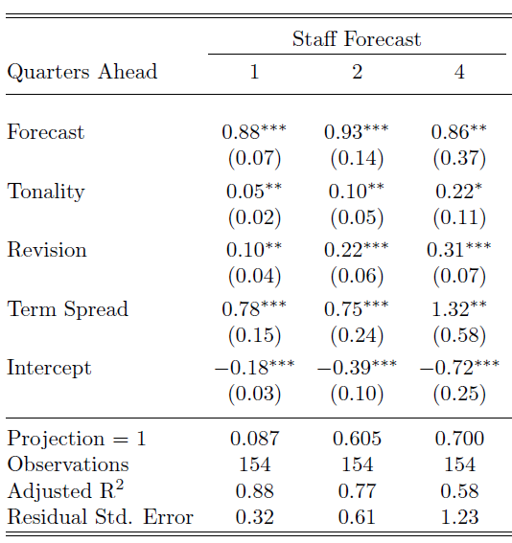
Predicting Funds Rate w/Trend Tonality & ST Spread
Term spread has strong predictive power, suggesting staff fed funds forecast does not incorporate all market information – Reifschneider and Tulip (2017).
However, Tonality still has marginal predictive power
Sharpe, Sinha, Hollrah
What’s the story
10/02/2017
31
Notes:
31

Slide 32
Outline
What is Tonality?
Tonality as an Economic Indicator
  Tonality and Blue Chip Forecasts
Tonality and Monetary Policy
Tonality and Asset Prices
Extensions
Sharpe, Sinha, Hollrah
What’s the story
10/02/2017
32
Notes:
32

Slide 33
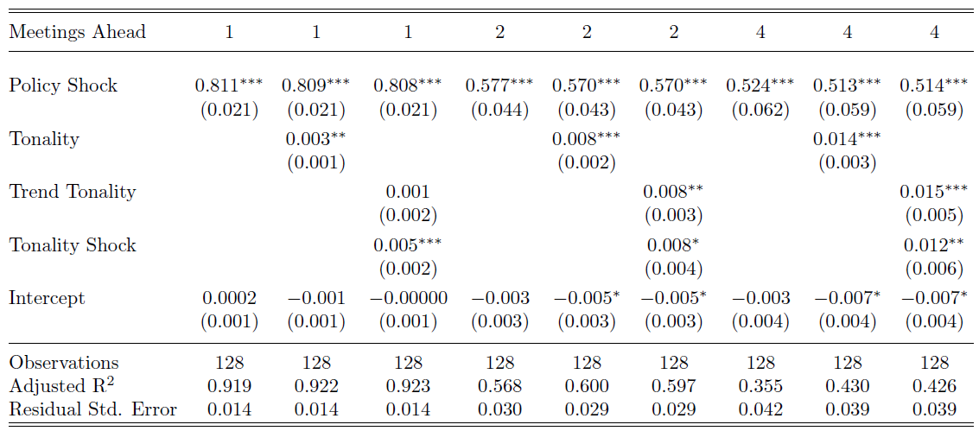
Tonality and Asset Prices: Post-FOMC Announcement
Higher Greenbook Tonality predicates a significant positive incremental reaction for Fed funds futures. Similar results for 6M, 2YR and 5YR rates but not for stocks
Sharpe, Sinha, Hollrah
What’s the story
10/02/2017
33
Notes:
33

Slide 34
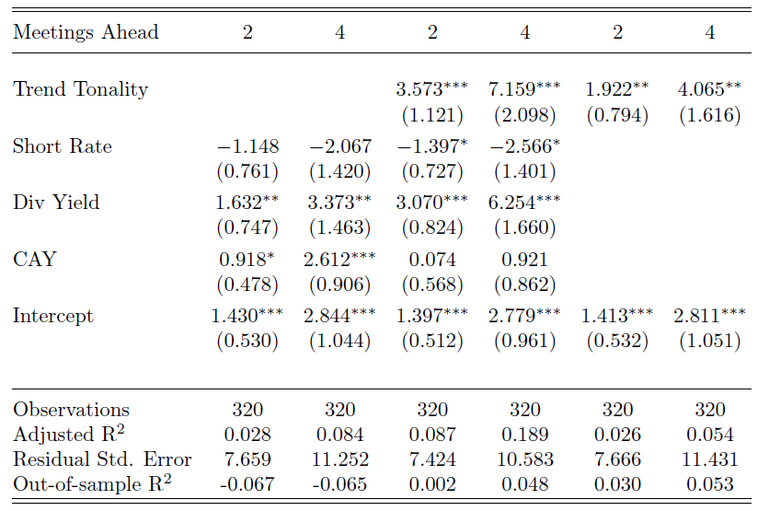
Tonality and Future Stock Returns
Does Tonality predict future stock return. Use full sample, since no break in Tonality and stock return relationship.
Sharpe, Sinha, Hollrah
What’s the story
10/02/2017
34
Notes:
34

Slide 35

Stock Return Predictability: Assessing the economic value of Tonality for equity investor
We use Campbell and Thompson (2007) framework. The gain in expected return from observing Tonality.
R² is out of sample R². S² is the Sharpe ratio.
Two-meeting-ahead R² = 3 percent implies 12.8 percentage point annual gain. Four-meeting-ahead R² implies to 11.7 percentage point annual gain.
Analysis ignores transaction costs and risk aversion.
Sharpe, Sinha, Hollrah
What’s the story
10/02/2017
35
Notes:
35

Slide 36
Outline
What is Tonality?
Tonality as an Economic Indicator
  Tonality and Blue Chip Forecasts
Tonality and Monetary Policy
Tonality and Asset Prices
Extensions
Sharpe, Sinha, Hollrah
What’s the story
10/02/2017
36
Notes:
36

Slide 37
Two Extensions
Positive vs Negative Tonality: For realized GDP growth the information is almost exclusively in the Trend Positivity. For unemployment rate, both Trend Positivity and Negativity contain information.
Predicting Recessions: Predicts 1,2, and 4 quarter recessions, even after controlling for term-spread and GZ (credit) spread.
Sharpe, Sinha, Hollrah
What’s the story
10/12/2017
37
Notes:
37

Slide 38
Conclusion
We find that the narrative presented along with numerical forecast has complimentary relationship with the numerical forecast.
  Studies that examine forecast efficiency should consider examining the “complimentary” information that is also communicated with the forecast.
Tonality predicts monetary policy surprises suggests policy makers absorb information from Tonality and communicate some information to market participants.
Tonality predicts 3-month and 6-month stock returns, notable but not surprising since it predicts economic growth.
Provide a promising example of “text as data.” Suggests why consumers of forecasts are paying for more than point estimates.
Sharpe, Sinha, Hollrah
What’s the story
10/12/2017
38
Notes:
38

