Slide 1
Simple and Robust Rules for Monetary Policy
John B. Taylor
Stanford University
John C. Williams
Federal Reserve Bank of San Francisco
The opinions expressed are those of the authors and do not necessarily reflect the
views of the management of the Federal Reserve Bank of San Francisco or anyone
else in the Federal Reserve System.

Slide 2
Outline
Historical background
Empirical experience
Characteristics of simple rules
Robustness
Optimal control vs. simple rules

Slide 3
Historical Background
Smith, Ricardo, Fisher, Wicksell, Friedman
Rules proposed in response to crises and excesses to reduce monetary shocks and mitigate other shocks
  Rules versus chaotic monetary policy
Rules as guideposts for policy
  Monetary growth targets
  Policy rules

Slide 4
1980s and 1990s:
Finding a Few Good Rules
Stochastic simulations of alternative policy rules in different estimated models
  Instrument choice (interest rate, monetary aggregate, exchange rate)
  Formal optimization techniques in simple models
  Evaluation of representative policy rules across models (Bryant-Hooper-Mann)
Long list of models
  1993: Brookings project (Bryant)
  1999: NBER Monetary Policy Rules (Taylor)
  Today: Model data base (Wieland)

Slide 5
Experience with Great Moderation
Many studies showing monetary policy more systematic and responsive during the Great Moderation than before
  Policy well described by policy rule (Clarida-Gali-Gertler, Judd-Rudebusch, Woodford)
  Timing suggestive but not definitive (Cecchetti, Stock and Watson)
Policy rule presriptions regularly discussed at central banks.

Slide 6
Evaluating Simple and Robust Rules
Characteristics of optimal simple rules
Robust Policies
Simple rules vs. Optimal policies

Slide 7
Central Bank Objective
Ad hoc quadratic central bank loss:
L = E{ (π- π*) ² + λy² + ν(i – i*) ²}
where E denotes the unconditional expectation, π is the inflation rate, π* is the inflation target, y is the output gap, and i is the nominal short-term interest rate.
The central bank loss can also be derived as the second-order approximation to household utility

Slide 8
Simple Policy Rules
Simple (three-parameter) rules:
i_{t} = (1-ρ)(π_{t} + r*) + ρ i_{t-1} + α(π_{t} - π*) + βy_{t}
ρ : policy inertia parameter
This type of rule inherently “leans against the wind” of deviations of objective variables from target values.

Slide 9
Policy Inertia in RE Models

Slide 10
Price Level Targeting (PLT)
Price-level targeting rules:
i_{t} = (1-ρ)(π_{t} + r*) + ρ i_{t-1} + α[ln(p_{t}) – ln(p_{t}*)] + βy_{t}
p_{t}* : price level target (deterministic trend)
PLT rules perform very well in a wide variety of forward-looking models, especially with ZLB, gap mismeasurement, learning (Eggertsson & Woodford, Reifschneider and Williams(2000), Orphanides and Williams (2002, 2008).
However, effectiveness of PLT depends critically on rational expectations; PLT rules can perform poorly in models with adaptive expectations (Taylor (1999), Levin and Williams (2003), Reifschneider and Roberts 2005, Williams 2006).

Slide 11
PLT vs. IT in RE Models

Slide 12
Robust Monetary Policy Rules
  Robustness: policy performs well across a wide spectrum of models and environments
Methodologies: Bayesian, robust control, minimax regret
  McCallum (1988), Taylor (1993), Levin et al (1999, 2003), Levin and Williams (2003), Orphanides and Williams (2002, 2008); Brock, Durlauf, and West (2003, 2007), Tetlow (2006), Brock, Durlauf, Nason, and Rondina (2007)

Slide 13
Types of Uncertainty
  Mismeasurement of data and gaps
Parameter values
  Model specification
    small-, medium-, large-scale
    closed vs. open economy
    expectations formation (adaptive, rational, learning)
    estimation sample

Slide 14
Gap Mismeasurement

Slide 15
Robustness to Model Uncertainty

Slide 16
Robustness to Bounded Rationality

Slide 17
Optimal Control Policy
Optimal control policy minimizes loss (Woodford 2003, Svensson-Woodford 2003, Giannoni-Woodford 2005)
Provides very small stabilization benefits over optimized simple rules.
Can be less robust to uncertainty than robust simple rules and be difficult to communicate.

Slide 18
Simple Rules vs. Optimal Control
Simple three-parameter rules perform nearly as well as the fully optimal policy in wide variety of empirical macro models , including the Fed’s large-scale FRB/US model (Levin and Williams 2003, Williams 2003, Orphanides and Williams, 2002, 2008) …
Source: Williams, FRBSF Economic Review (2003).

Slide 19
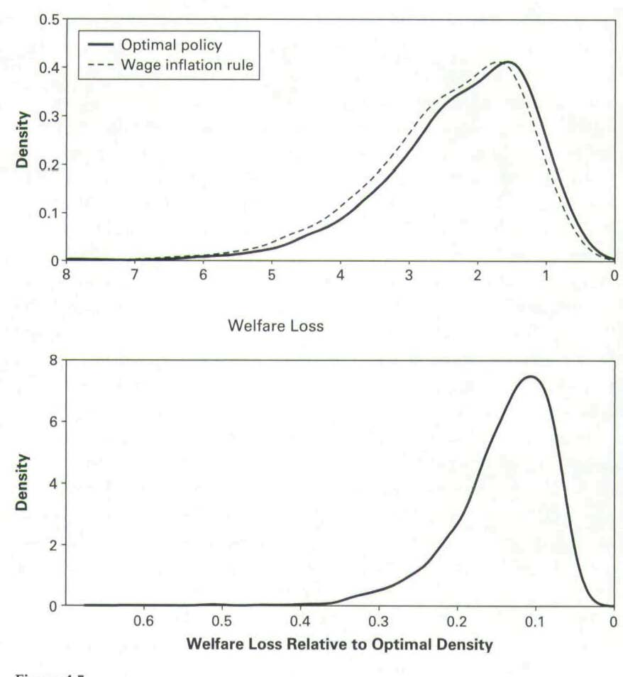
Simple Rules vs. Optimal Control
… and medium-scale DSGE models (Schmitt-Grohe and Uribe, 2005, Levin-Onatski-Williams-Williams 2005)
Source: Levin, Onatski, Williams, Williams, NBER Macro Annual (2005).

Slide 20
Robustness of Optimal Control Policy

Slide 21
Counterfactual Simulation of Optimal Control Policy

Slide 22
Counterfactual Simulation of Robust Policy Rule

